Slide 1
Covid-19 Decision Trees Project
Noah Zaleski, Carl Martin, Alex Ruvolo

Slide 2
Data Description
Main topic is Covid-19
Consists of about 1,000,000 hospital patients from Mexico
Response Variable: Status of patient (Alive = 1/Dead = 0)
Contained 21 unique factors and we included 19
Removed variables specifically related to only dead patients
The remaining variables consisted of factors like sex, age, type of hospital care, current health conditions, and current habits
There were some missing values that were already labeled
Testing and training was determined randomly with 50% being labeled into each group (0 = testing & 1 = training)

Slide 3
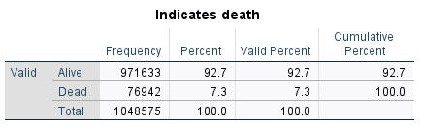
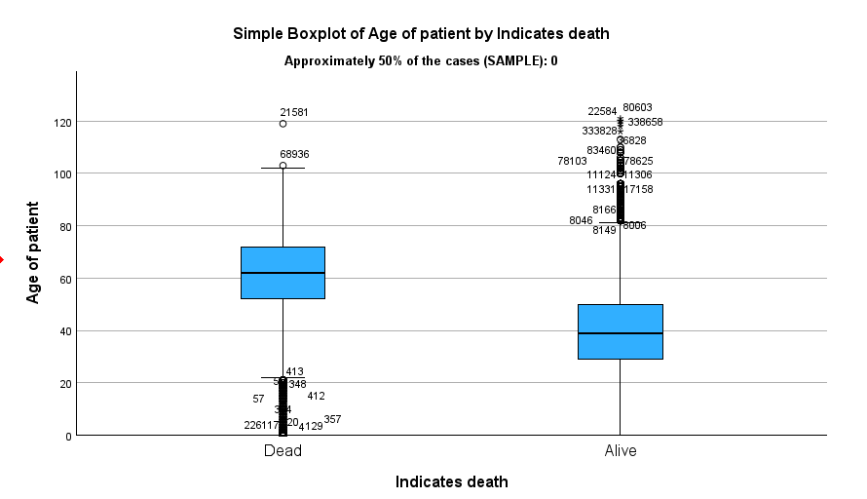
Important Preliminary Statistics
Low percent of dead patients
Caused us to set a 75% threshold for each model
Alive patients tended to be younger than the dead patients
Dead distribution is skewed left
Alive distribution is skewed right

Slide 4
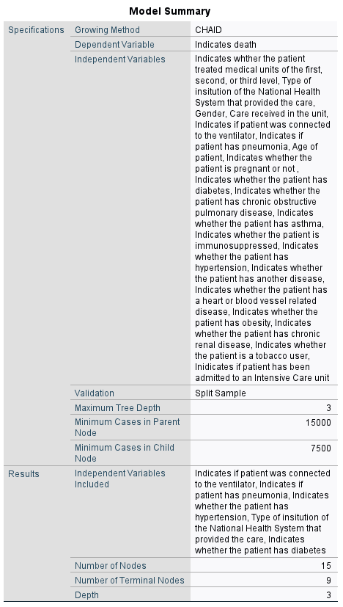
CHAID Model Summary
Included all variables
5 were used in the final model
Best maximum parent node size: 15,000
Best maximum child node size: 7,500
15 Nodes
9 Terminal Nodes
3 Levels

Slide 5
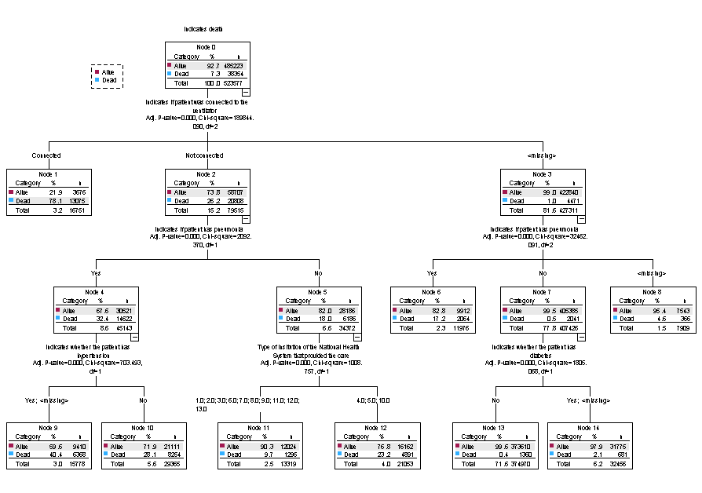
CHAID Decision Tree Level 1

Slide 6
CHAID Decision Tree Levels 2 & 3

Slide 7
CHAID Story
People who were most likely to live were those with a missing value for the ventilator, did not have pneumonia, and did not have diabetes, with 99.6% of them living
People who were next most likely to live were those with a missing value for the ventilator, did not have pneumonia, and either had diabetes or missing, with 97.9% of them living
People who were most likely to die were those who were connected to the ventilator, with 78.1% of them dying
People who were next most likely to die were those who were not connected to the ventilator, had pneumonia, and either had hypertension or missing, with 40.4% of them dying

Slide 8
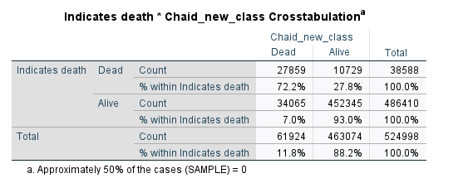
CHAID Risk, Sensitivity, & Specificity
Risk = 44794/523577 = 0.085
Sensitivity = 93.0%
Specificity = 72.2%
8.5% of responses were incorrectly predicted
Very good at predicting if
patients lived

Slide 9
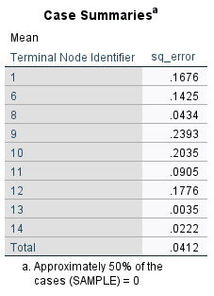
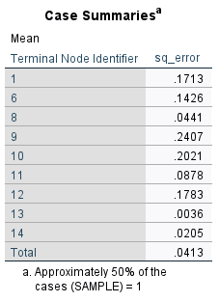
CHAID ASE
Node 9 was predicted with the least accuracy
Node 13 was predicted with the most accuracy
Overall ASE for the testing set is 0.0412
Does not appear to be overfitting

Slide 10
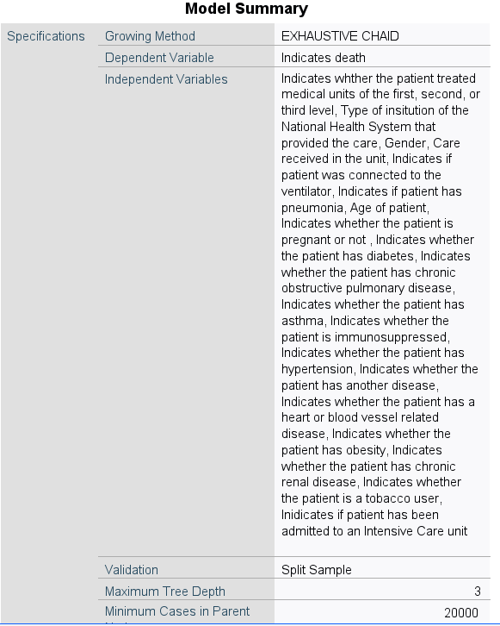
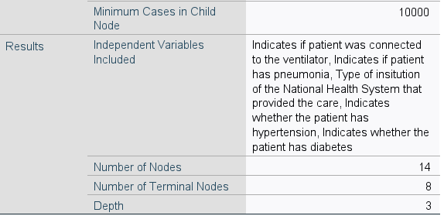
Exhaustive CHAID Model Summary
Included all variables
5 were used in the final model
Best maximum parent node size: 20,000
Best maximum child node size: 10,000
14 Nodes
8 Terminal Nodes
3 Levels

Slide 11
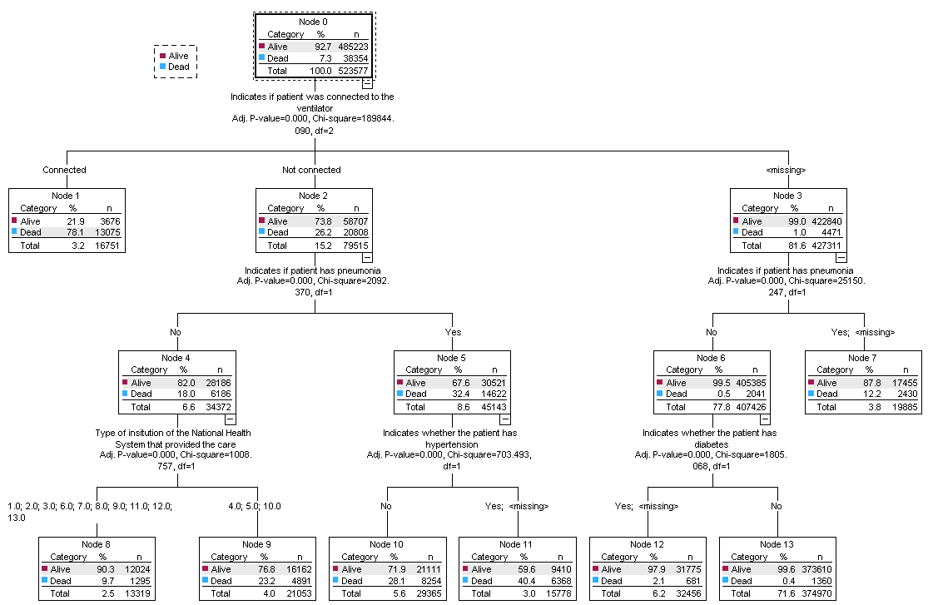
Exhaustive CHAID Decision Tree Level 1

Slide 12
Exhaustive CHAID Decision Tree Levels 2 & 3

Slide 13
Exhaustive CHAID Story
People who were most likely to live were those with a missing value for the ventilator, did not have pneumonia, and did not have diabetes, with 99.6% of them living
People who were next most likely to live were those with a missing value for the ventilator, did not have pneumonia, and either had diabetes or missing, with 97.9% of them living
People who were most likely to die were those who were connected to the ventilator, with 78.1% of them dying
People who were next most likely to die were those who were not connected to the ventilator, had pneumonia, and either had hypertension or missing, with 40.4% of them dying

Slide 14
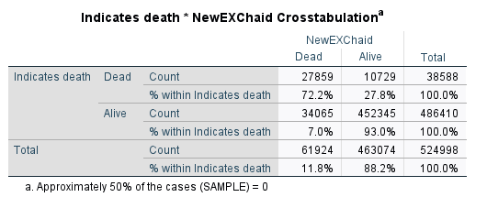
Exhaustive CHAID Risk, Sensitivity, & Specificity
Risk = 44794/524998 = 0.085
Sensitivity = 93.0%
Specificity = 72.2%
8.5% of responses were
incorrectly predicted
Very good at predicting if
patients lived

Slide 15
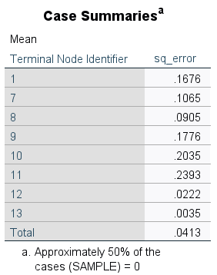
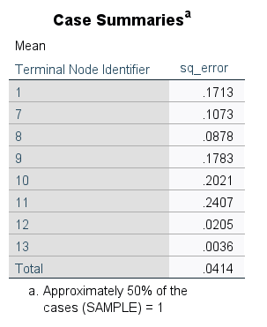
Exhaustive CHAID ASE
Node 11 was predicted with the least accuracy
Node 13 was predicted with the most accuracy
Overall ASE for the testing set is 0.0413
Does not appear to be overfitting

Slide 16
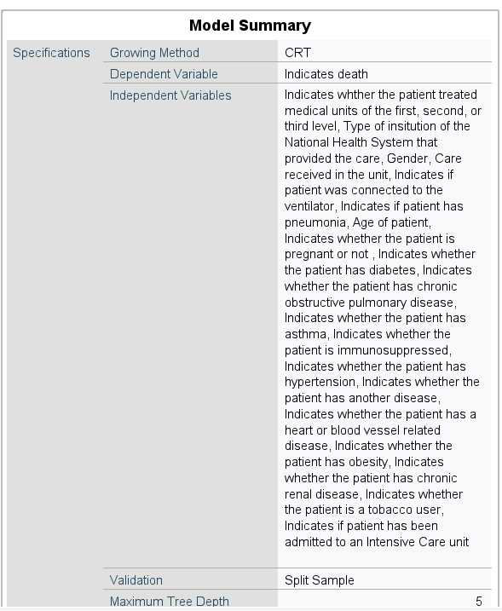
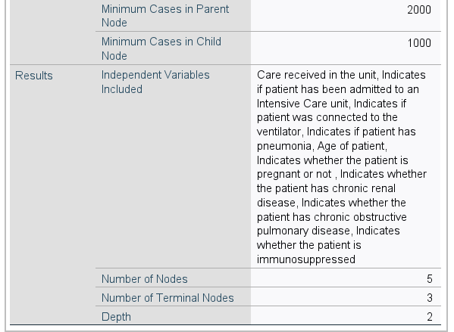
CART Model Summary
Included all variables
9 were used in the final model
Best maximum parent node size: 2,000
Best maximum child node size: 1,000
5 Nodes
3 Terminal Nodes
2 Levels

Slide 17
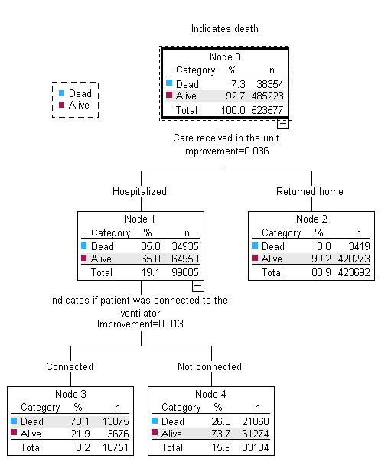
CART Decision Tree

Slide 18
CART Story
People who were most likely to live were those who were sent home upon receiving care, with 99.2% of them living
People who were next most likely to live were those who were hospitalized and not connected to the ventilator, with 73.7% of them living
People who were most likely to die were those who were hospitalized and connected to the ventilator, with 78.1% of them dying

Slide 19
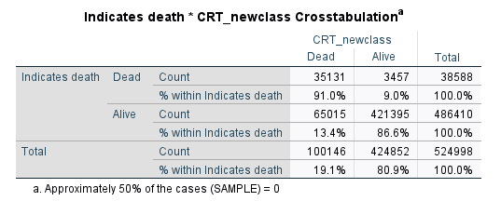
CART Risk, Sensitivity, Specificity
Risk = 68472/524998 = 0.130
Sensitivity = 86.6%
Specificity = 91.0%
13.0% of responses were
incorrectly predicted
Very good at predicting if
patients lived and if patients
died

Slide 20
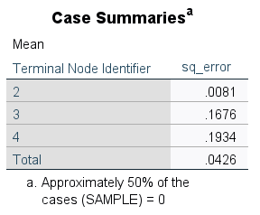
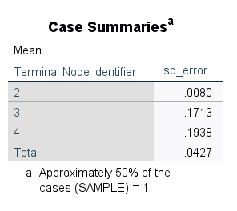
CART ASE
Node 4 was predicted with the least accuracy
Node 2 was predicted with the most accuracy
Overall ASE for the testing set is 0.0426
Does not appear to be overfitting

Slide 21
Logistic Regression
The total number of steps in the full logistic regression was 17
We decided to cut off the logistic regression at a step where the data stopped improving
Stopped after 3 steps with the Wald method, and then switched to the enter method
The three variables ended up being an indication if the patient was connected to the ventilator, an indication if the patient had pneumonia, and the age of the patient
At this step, based on the Wald method, the sensitivity is 93%, the specificity is 42.8%, and the overall correct is 77.4%
The best these become throughout all of the steps is 95% for the sensitivity, 45.5% for the specificity, and 77.9% for the overall, so the step three results are not that far off from the best possible

Slide 22
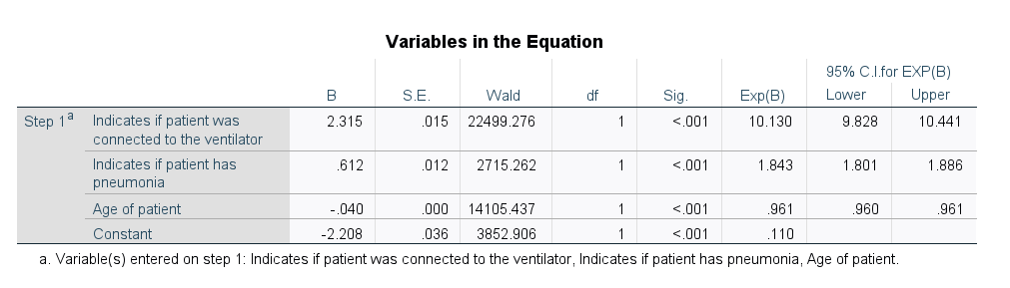
Logistic Regression Model Summary
Wald Method first
Variables ordered by highest Wald statistic
Found best step where model stopped greatly improving
Enter Method
3 variables

Slide 23
Logistic Regression Story
While adjusting for the other variables in the model, the predicted odds of living are 10 times greater for someone who is connected to the ventilator
While adjusting for the other variables in the model, the predicted odds of living increase by 84.3% if the patient has pneumonia
While adjusting for the other variables in the model, the predicted odds of living decrease by 3.9% for every 1 additional year in age

Slide 24
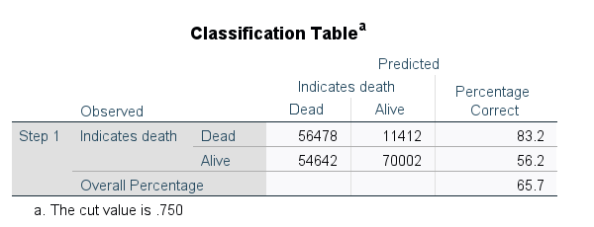
Logistic Regression Risk, Sensitivity, Specificity
Risk = 100 - 65.7 = 34.3%
Sensitivity = 56.2%
Specificity = 83.2%
34.3% of responses were
incorrectly predicted
Good at predicting if
patients died

Slide 25
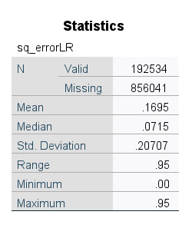
Logistic Regression ASE
Overall ASE is 0.1695

Slide 26
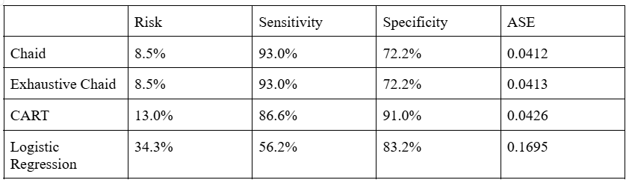
Model Evaluation

Slide 27
Best Model
Logistic Regression is the worst
CHAID is slightly better than Exhaustive CHAID
Depends on if we value a lower risk or a high sensitivity and specificity
The CHAID model has the lowest risk, but a lower specificity
The CART model has a high specificity and high sensitivity, but a higher risk
The risk is inflated due to the sensitivity, since most patients were categorized as alive (7.3% classified as dead)
Do we want to predict more people as likely to live and possibly have more people die
because of this or do you want to predict more people as likely to die and have some people spend money and time to fix an unneeded situation?
Under these conditions, we believe the best model is the CART model because, though it is lacking in the best predicting, just because of the hospital setting, it is the job of the workers
to save the most amount of people possible, and this model contains a broader range of who
is likely to die

